Slide 1
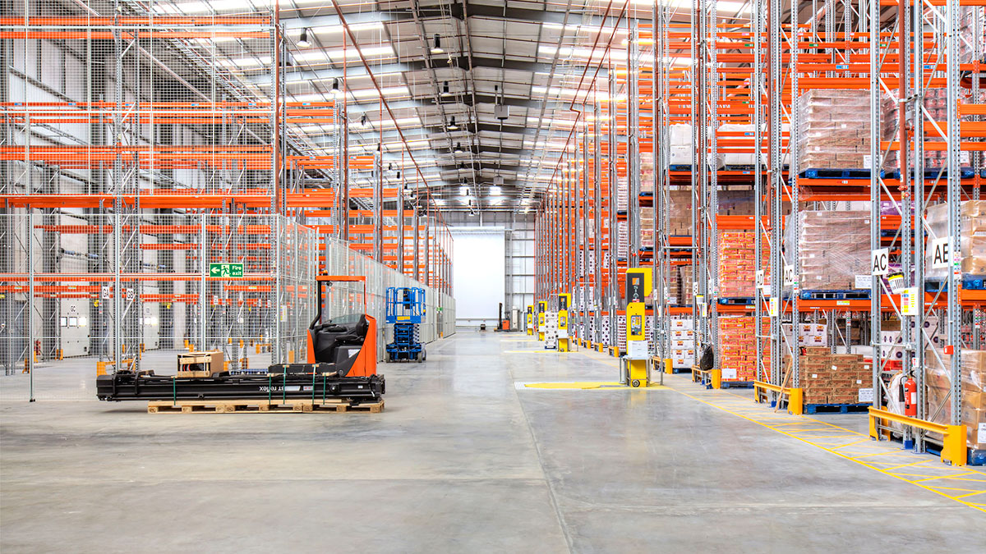
Warehouse Analysis
Evaluation only.
Created with Aspose.Slides for .NET Standard 2.0 23.5.
Copyright 2004-2023Aspose Pty Ltd.
Orders/day for the last 5 weeks

Slide 2
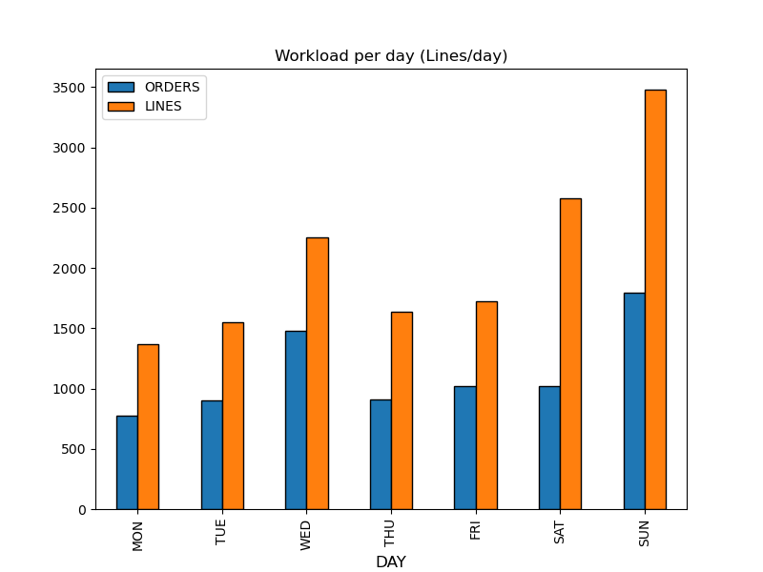
Warehouse Workload (WEEK-1)
Evaluation only.
Created with Aspose.Slides for .NET Standard 2.0 23.5.
Copyright 2004-2023Aspose Pty Ltd.
Analysis
• 14,583 lines have been prepared during the week
• Sunday has been the busiest day with 3,479 lines prepared
• 1.85 lines/order on average with a maximum of 2.52 lines/order
1/6

Slide 3
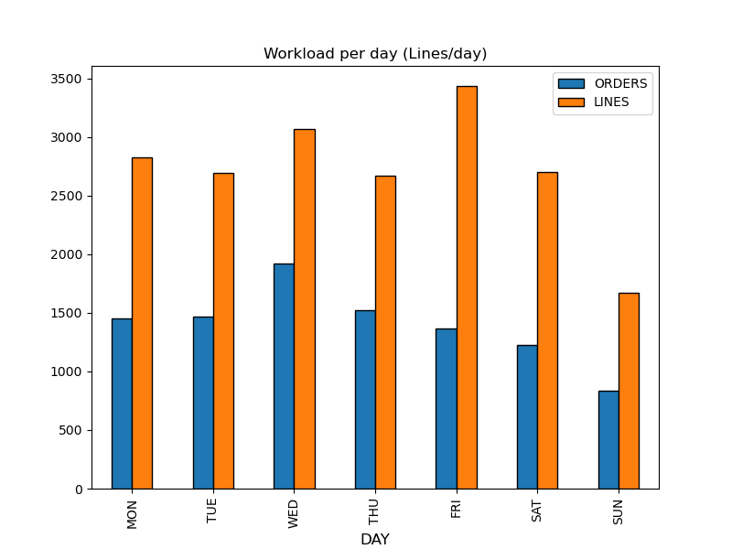
Warehouse Workload (WEEK-2)
Evaluation only.
Created with Aspose.Slides for .NET Standard 2.0 23.5.
Copyright 2004-2023Aspose Pty Ltd.
Analysis
• 19,071 lines have been prepared during the week
• Friday has been the busiest day with 3,436 lines prepared
• 1.98 lines/order on average with a maximum of 2.51 lines/order
2/6

Slide 4
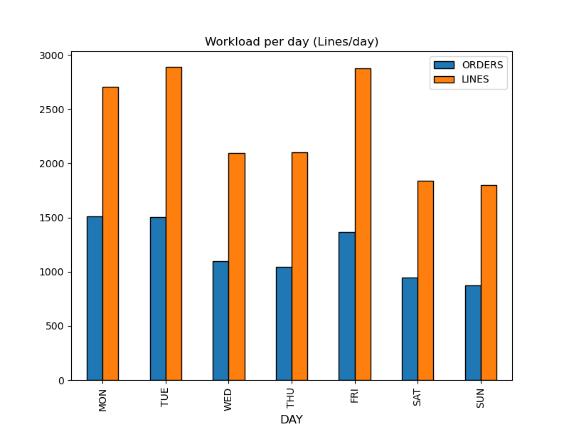
Warehouse Workload (WEEK-3)
Evaluation only.
Created with Aspose.Slides for .NET Standard 2.0 23.5.
Copyright 2004-2023Aspose Pty Ltd.
Analysis
• 16,296 lines have been prepared during the week
• Tuesday has been the busiest day with 2,889 lines prepared
• 1.96 lines/order on average with a maximum of 2.10 lines/order
3/6

Slide 5
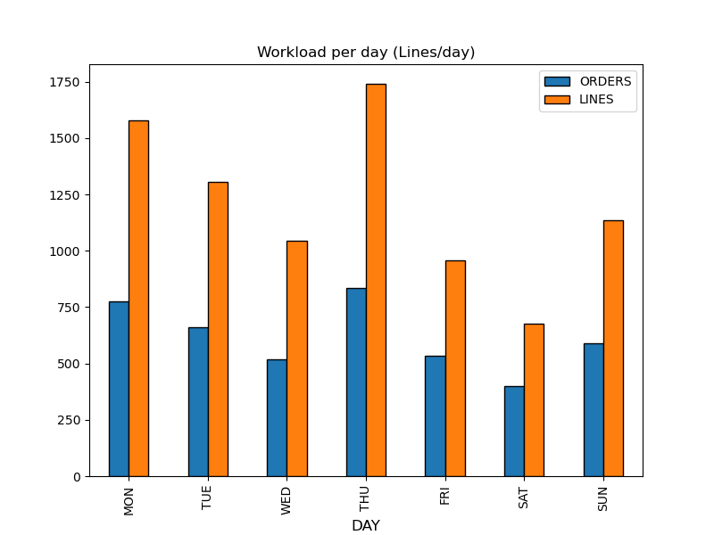
Warehouse Workload (WEEK-4)
Evaluation only.
Created with Aspose.Slides for .NET Standard 2.0 23.5.
Copyright 2004-2023Aspose Pty Ltd.
Analysis
• 8,438 lines have been prepared during the week
• Thursday has been the busiest day with 1,741 lines prepared
• 1.93 lines/order on average with a maximum of 2.09 lines/order
4/6

Slide 6
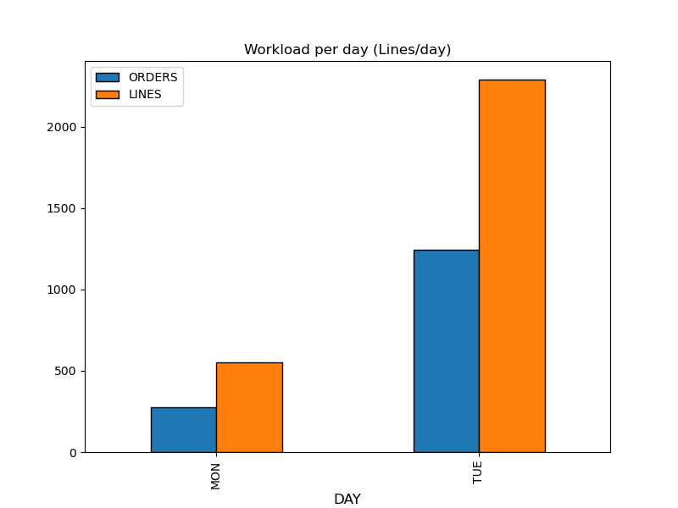
Warehouse Workload (WEEK-5)
Evaluation only.
Created with Aspose.Slides for .NET Standard 2.0 23.5.
Copyright 2004-2023Aspose Pty Ltd.
Analysis
• 2,841 lines have been prepared during the week
• Tuesday has been the busiest day with 2,291 lines prepared
• 1.91 lines/order on average with a maximum of 1.98 lines/order
5/6

Slide 7
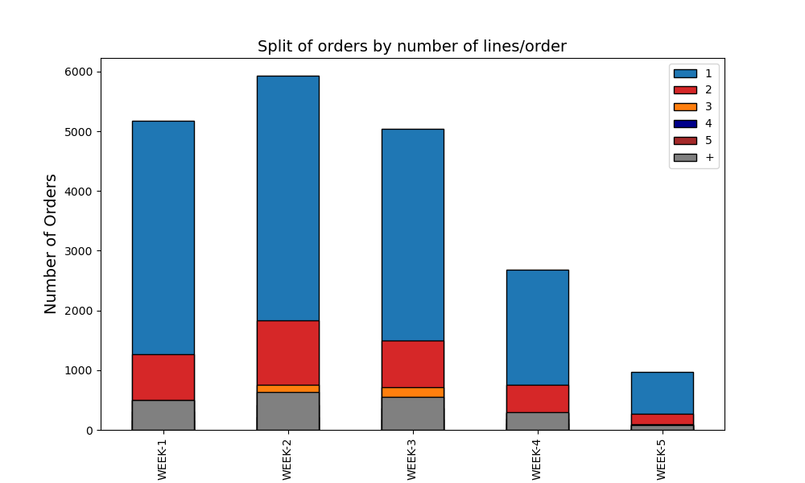
Order Profile
Evaluation only.
Created with Aspose.Slides for .NET Standard 2.0 23.5.
Copyright 2004-2023Aspose Pty Ltd.
31,874 orders prepared
62.1% of orders with 1 line(s) per order prepared
17.6% of orders with 2 line(s) per order prepared
7.4% of orders with 3 line(s) per order prepared
6/6
6/6
6/6

